Slide 1



Rehabilitation Plan: Guidance
Sophie Peacock
Major Trauma Rehabilitation Coordinator
RIE, Edinburgh
Karen Scott
Consultant AHP, Major Trauma
QEUH, Glasgow
May 2021
Notes:
This presentation has been created to support and guide you in completing the Major Trauma Rehabilitation Plan in your healthcare setting. The aim of this presentation is to give you an overview of the rationale and background to the documentation, as well as provide clear guidance for how to use and complete it effectively, to encourage some continuity in how this is done across the regions.
It is advised to use this in conjunction with the Scottish Trauma Network Rehab Plan Operational User Guidance document which has been created alongside this presentation. The Rehab Plan is still a working document which is being reviewed continuously. Over the next 6-12 months, we aim to trial it across the West and South East Trauma Networks in practice to ensure it is fit for purpose and meaningful to clinicians and patients alike. If you have any comments, questions or feedback, please get in touch with Sophie or Karen directly and we will collate and action any comments.

Slide 2
Key Performance Indicators (KPI)
3.1.1 Assessment of rehabilitation needs: Major trauma patients admitted to a MTC have a rehabilitation plan written
3.1.2 Time to assessment of rehabilitation needs: Major trauma patients admitted to a MTC, who have a rehabilitation plan, have it written within three days of admission.
KPI currently will only reported for patients ISS >15 and admitted to a major trauma centre
KPI for the Scottish Trauma Network
Notes:
Following a long consultation process, the Scottish Trauma Network agreed a series of national key performance indicators to measure and help monitor the success of the network and drive improvements. The KPIs are aimed at ensuring the correct functioning of the network at all stages from pre-hospital care through to rehabilitation and longer term follow up.
In the ongoing hospital care section, there are 2 KPIs directly relating to rehabilitation.
First being that all major trauma patients admitted to an Major Trauma Centre have a written rehabilitation plan.
And the second that patients admitted to an Major Trauma Centre that have a rehabilitation plan, have it written within 3 days of admission.
The rehab KPIs will currently only apply to patients who were admitted to a major trauma centre with an ISS over 15. They will not be formally reported on until the West and South East Trauma Networks go live later in 2021. Although the KPI does not apply to the Trauma Units at present, there is a consensus that all Trauma Units should be aiming to meet this as best practice. With the extensive infrastructure of Major Trauma and Rehabilitation Coordinators now in place across the network, it is likely that this will be reviewed in the future to apply universally.
For details on the full list of KPIs then follow the link on screen

Slide 3
Rationale
Rehabilitation should start as soon as appropriate to enable patients to achieve their functional potential
Early, intensive rehabilitation = better outcomes
Major trauma results in a complex range of impairments and disabilities
RP allows for full, early and continuing identification of all of the problems that need to be considered and resolved to inform planning and delivery of on-going rehabilitation care
“Giving Lives Back”
Notes:
Rehabilitation is a process of assessment, treatment and management with ongoing evaluation, which should start as soon as appropriate to enable patients to achieve their maximum functional potential for participation in society and quality of living. The rationale behind the decision to implement a written rehabilitation plan is based on the wealth of evidence that early, intensive, multidisciplinary rehabilitation aids recovery and improves outcomes for patients following significant injury.
Major trauma results in a complex range of impairments and disabilities which typically include a mixture of physical, cognitive, emotional, social and behavioural problems. The Rehab Plan allows for full, early and continuing identification of all of the problems that need to be considered, describing the rehabilitation needs and recommendations in sufficient detail to inform planning and delivery of on-going rehabilitation care.
All of this will help us to ensure the patient gets the right care, in the right place, at the right time in order to deliver on the Scottish Trauma Network’s aim of not only saving lives, but “Giving Lives Back”.

Slide 4
Purpose of the Rehabilitation Plan
Provides a clear summary of what injuries have been sustained, management, who is responsible and what is still outstanding.
Describes all needs relevant to rehabilitation at specified times
Ensures that all information concerning injury management, especially ongoing needs and long-term goals, is transferred at all transitions of clinical care
Includes patient led goals - engage and empower the patient in rehabilitation
Notes:
The rehabilitation plan is a transformative tool that should allow a bespoke approach to each patient’s specific needs.
The Rehab plan provides a clear summary of what injuries have been sustained, the management plan that has been put in place, who is responsible for the management and what is still outstanding.
The rehab plan will also help to improve communication between care providers by ensuring that all information concerning management, especially ongoing needs and long-term goals, is accurately transferred at all transitions of clinical care.
A key aim of the rehab plan is to empower the patient in the process of their rehabilitation, with the aim of improving engagement and buy in. As far as possible, the rehab plan should be created and updated in partnership with the patient and/or their family, ensuring that goals and actions are patient led and not dictated to them.
It should give patients and GPs, as well as rehab professionals, oversight of the identified needs and recommended treatment or required actions, helping to streamline the patient journey.

Slide 5

Development
NoS and EoS using different RP format – not feasible
SEoS and WoS agreed to work together to try and agree on a universal version for central belt
Draft developed with Rehabilitation Medicine Consultants and AHPs across network - piloted late 2020 and detailed feedback gathered
Updated draft agreed upon in March 2021 to be trialled for 2021
Long term aim to develop electronically with desire for “Once for Scotland” approach
Notes:
As North and East networks have been live for over 2 years now, the rehabilitation KPIs are live in those regions. They developed a rehabilitation plan format which was adapted from a rehabilitation prescription template from the north of England. This format is quite a lengthy document, and when trialled in the West of Scotland, it was felt it would not be feasible to complete this documentation for the large volume of trauma in the West. It was agreed that the West would work in collaboration with the South East network to develop an agreed tool that was fit for purpose in the busier networks in the Central Belt. There are several Trauma Units that will deal with both West and South East regions, so using the same paperwork in both MTCs will be advantageous for continuity.
A draft was developed in line with British Society of Rehab Medicine guidance on specialist rehabilitation prescription and the updated 2019 Rehabilitation Prescription guidance from the Trauma Audit Research Network in England. Towards the end of 2020, this draft was trialled in practice across the regions and detailed feedback gathered from a wide variety of AHPs in various settings. Amendments were made to the document to address all issues raised. We now aim to trial the updated draft in practice for the remainder of 2021, continuing to gather feedback about changes that need to be made.
There is the longer term aim to develop the RP electronically once the networks are happy that the content is fit for purpose. This version is also being presented to the national STN rehab group as there is a desire for a “once for Scotland” approach.

Slide 6
Considerations and Recommendations
ISS ≠ complexity of rehab needs
ISS retrospective score and often not available before day 3 - decision to initiate a RP should be based on clinical judgement
Be needs led - Encouraged to complete for moderate trauma, despite KPI not applying
Needs whole MDT engagement to complete comprehensively
Update at each point of transfer, if there is a significant change and at discharge as a minimum
Notes:
It is worth noting that the ISS is calculated retrospectively and relates to severity and likelihood of death from an injury, and this does not always correlate well with complexity of rehab needs or the functional and psychological burden of injury. It is also often rare that an accurate ISS will be available before the KPI cut off at day 3 of admission so clinical judgement is essential when making the decision to initiate a Rehabilitation Plan for a patient.
Furthermore, experience from the North and East Trauma Networks, as well as evidence from England, suggests that moderate trauma patients (being ISS between 9 and 15) often benefit more from having their rehab needs assessed and a plan written than some major trauma patients who have minimal long term impact from their injuries. It is therefore important to be needs led in this process and not overly focussed on ISS as the sole criteria for completion, even though the KPI does not currently apply to moderate trauma. In England, patients with an ISS score of 9 or more all receive a RP as it is considered best practice.
To be of true value, the rehabilitation plan needs to be completely comprehensively and consistently with engagement and input from the whole MDT. Depending on the local processes in place, the completion of the rehabilitation plan may be initiated, facilitated or supported by a Major Trauma Coordinator or Rehabilitation Coordinator. You should familiarise yourself with the local agreement at your place of work, however, to ensure accuracy of detail, the responsibility for contributing clinical detail to rehabilitation plan lies with the assessing and treating clinician.
Once initiated, as a minimum, it is recommended that the rehab plan is updated at each point of transfer of care, if there is a significant change in their presentation and before discharge. However, it would be beneficial to try and put processes in place to keep the paperwork as up to date as possible, as a “live” record of the patients progress and needs. This will also reduce the workload to update it before discharge.

Slide 7
Completing the Rehabilitation Plan
First 4 pages of the document are the standard RP and should be completed for all patients
Should be written in patient friendly language but also contain sufficient clinical detail
Appendix 1: must be completed for those requiring specialist rehab but can also form transfer summary
STAG Minimum Dataset should be completed by day 30 or discharge
Issue patient with a copy at point of discharge/transfer
Notes:
The first 4 pages of the document are the standard rehabilitation plan and should be fully completed for all patients. The language used needs to be clear and easily understandable for patients but also contain sufficient clinical detail. Try to avoid abbreviations or lots of medical jargon and make sure any content is accurate and appropriate for sharing with the patient. Use your clinical judgement to ensure you are setting it at the right level for each individual patient, as understanding will vary.
The rest of the document is termed Appendix 1: which is a checklist across a variety of categories to give details of thorough assessments and progress. This must be completed for patients who require referral to specialist rehabilitation, but can also be completed as a detailed transfer summary for repatriations or referral to other destinations such elderly rehab or community services.
To be most effective, the patient and/or their families should be given a copy of their rehab plan at the point of discharge or transfer and the content explained to them so that they fully understand the plan, their responsibilities and what to expect going forward. They should be provided with the details of a “keyworker” as the single point of contact should they have any issues following discharge.
The STAG Minimum Dataset document must then be completed by day 30 or discharge to provide details of the rehabilitation plan completion to STAG.

Slide 8
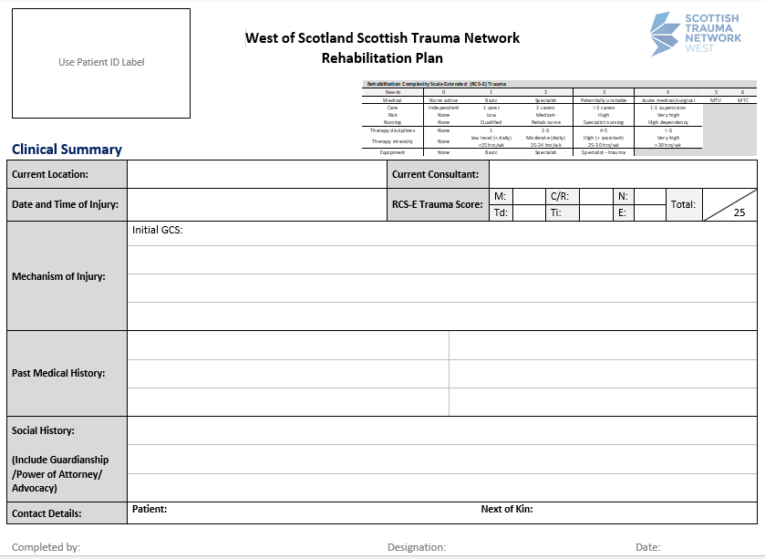
Summary of reason for admission
PMH and SH
Current RCS score
Notes:
Hopefully you now have a good awareness of the background to the development of the rehabilitation plan and understand the rationale and benefits of completing it. The next series of slides have been created to support you in actually completing the paperwork.
The first page of the rehabilitation plan provides a summary of the patient demographics, reason for admission and details about pre-morbid function. Ensure you record accurate information about the hospital, ward and admitting specialty as well as the consultant in charge of the patients care.
In the mechanism of injury section, detail how the injury occurred in as much detail as possible including initial GCS and any significant delays during pre-hospital intervention: such as prolonged extrication or a long lie before being found. If the mechanism is a Road Traffic Collision, also include speed and direction of collision if known.
Record any known previous medical history, including psychological and mental health history.
Document a comprehensive social history including accommodation type, previous level of function, mobility and cognition. Detail any existing equipment or Package of Care, social support network and employment or vocational status. Include information on: guardianship/Power Of Attorney/advocacy, risky behaviours to consider for discharge, police proceedings and details of any other agencies the patient is known to. Also record accurate details for the patient’s next of kin.
The Rehabilitation Complexity Scale Extended Trauma version (RCS-ET) has been identified by the BSRM as a simple overall measure of Care, Nursing, Therapy, Medical and Equipment needs, and is designed to offer a crude banding of complexity. This should be completed on admission and discharge as a minimum but recommended at regular intervals or when there is a significant change identified. On this first page, put the score at the time of initiating the RP. Subsequent scoring can be detailed in the Outcome Measure section in Appendix 1. Scoring should be based on what the patient needs, rather than what the patient is receiving. Please refer to the STN narrated powerpoint on the Rehab Complexity Scale for support on how to complete this measure effectively.

Slide 9
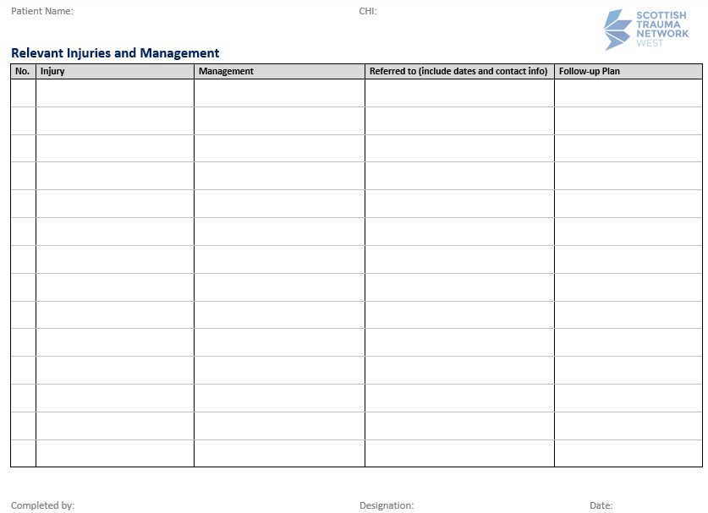
Summary of:
Injuries sustained
Management of injuries
Where/who referred to including contact info
Follow up plan
This will reduce injuries being missed that are identified at a later stage
Notes:
On page 2, record all injuries that have been identified. Against each injury - record the management plan, including any theatre dates and details around procedures. Include any advice, restrictions or post op instructions with clear timescales. Record details of specialties or services referred to, detailing the date referred and a contact number. Document planned follow up including clinic appointments dates, instructions and timescales for progression of weight bearing status or dates for review or removal of orthoses. Keep this list under regular review to ensure any additional injuries that are picked up at a later point, such as via tertiary survey, are recorded and addressed.
Try to include as much relevant detail as possible. The list should include patient friendly terms so that they can understand: be succinct but use anatomical language. It may be appropriate to put layman’s terms in brackets after anatomical descriptions, but make a judgement based on the patient’s level of knowledge and understanding.

Slide 10
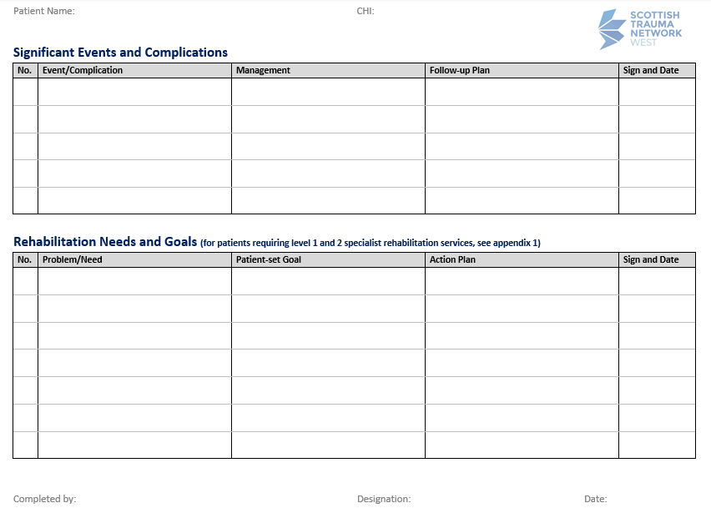
List of any significant events that occurred e.g. MI/Seizures
Patient set goals related to specific problem/need and action plan to achieve goal
Goals should be set by the patient but encouraged to be SMART
Likely longer term goals
Notes:
On page 3, list any significant events that occurred that you feel have had an impact on the trajectory of the patient journey. Examples might be: new onset of post traumatic seizures, iatrogenic problems, miscarriage, myocardial infarction or cardiac arrest with prolonged downtime, important transfers of care, medical deterioration, dates and outcome of extubation or decannulation, infection etc. Include details of how these events were managed and if any follow up actions are required so that these are not missed.
Record ongoing rehab need and agreed goals - these should be MDT patient led goals not individual therapy discipline goals – Goals should be developed in collaboration with the patient to ensure they encompass personal outcomes and what is important to the patient rather than your profession. Guide the patient to make goals that are Specific, Measurable, Achievable, Realistic and Timed. Continue to document profession specific goals in your own clinical records.
In the action plan, detail how the goal is going to be achieved. Include timescales to help address patient expectations.

Slide 11
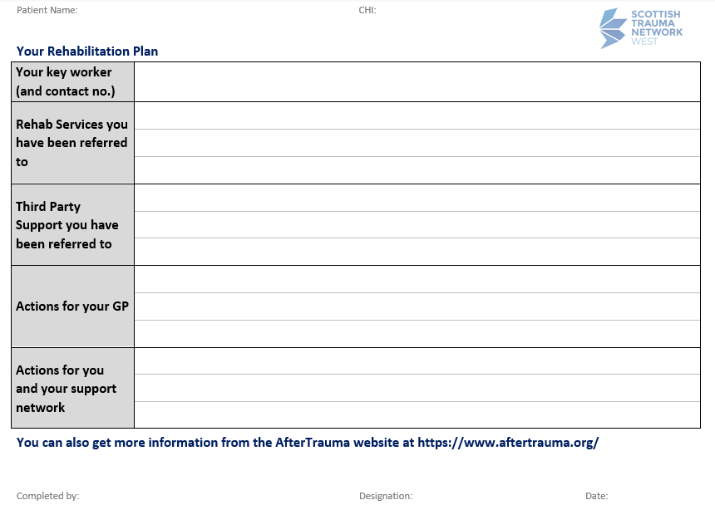
Contact details for MTC
Onward referrals and contact details
Any actions required by GP
Any actions for patient family
Notes:
Page 4 should be a summary of information for the patient, their families and the GP. Patients should be provided with details for a single point of contact that they can approach with questions or issues following discharge. In your area, this may be a Major Trauma Coordinator or a Rehabilitation Coordinator, but could also be an allocated Key Worker from the MDT who agrees to be the point of contact. This will help the patient access appropriate support or signposting quicker.
Include details of any onward referrals that have been made, including contact details. Detail any outstanding actions for the patients GP as well as any actions required by the patient or their support network.
These 4 pages should be issued to the patient and the information included explained to the patient at the point of discharge or transfer.

Slide 12
Appendix 1
Specialist Rehabilitation Plan
Includes findings of thorough assessment highlighting the subsequent rehab needs
This section is for use by staff, so professional language can be used
MUST be filled in if the patient requires Specialist Rehabilitation
Each profession should complete the relevant section of the form providing up to date summary
A copy should be sent to next care provider
This should be signed off by a Rehabilitation Medicine Consultant or designated deputy
Can also be filled in by AHP staff to use as a transfer or discharge summary
Notes:
This appendix expands on the standard RP above to set out in more detail the nature of the rehabilitation needs and record baseline values for the core measures that are used to assess complexity and outcomes. This more thorough assessment provides detail on items of routine evaluation within specialist rehabilitation services. It should detail the patient’s progress over time alongside, input to date and recommendations to address ongoing rehab needs. This section is for use by staff, so professional language can be used. It must be completed for those patients being referred to specialist rehabilitation. Each profession from the MDT should contribute to the completion of relevant sections. A copy should be sent with the patient to the next care provider.
Ideally, this should be signed off by a Consultant in Rehabilitation Medicine or a designated deputy at discharge from the Major Trauma Centre or Trauma Unit.
You can also choose to complete this as a detailed transfer summary for patients to improve communication and transfer of information when repatriating or referring to other destinations such elderly rehab or community services.

Slide 13
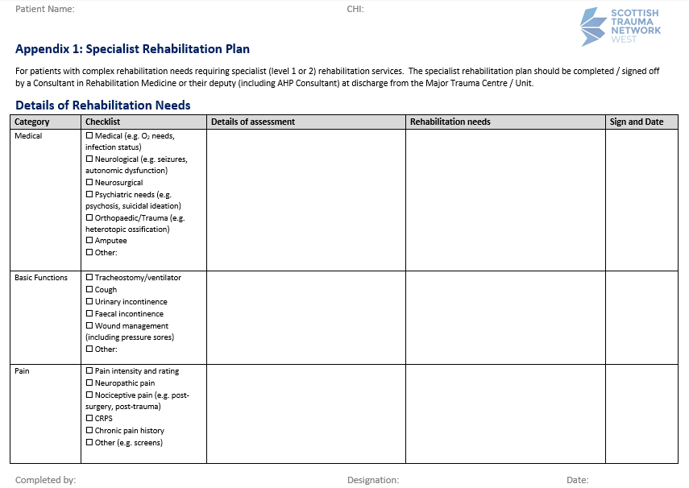
Medical: ongoing medical or surgical needs
Basic functions: ventilatory status, continence, wound management
Pain: type/intensity, VAS, pain team advice
Notes:
First, detail any ongoing medical or surgical needs. Encourage medical and nursing staff to engage with completion of this section. This may include information on oxygen requirements, infection status, seizures, surgical complications etc.
For basic functions, include information on ventilatory status - if requiring respiratory support or weaning then explain the needs. If the patient has a trache include details on what size, if the cuff is up or down and how it is being managed. Include details on cough and secretion clearance. Include details on functions such as continence management – details of bowel regime, if a catheter in-situ with timeframes etc. Include details on wound management such as dressings, clips/sutures and pressure areas.
For pain, detail the type and intensity of pain at rest and dynamically during activities. Record using VAS or other objective marker. Detail any pain team input or advice and include details of any chronic pain history to consider.

Slide 14
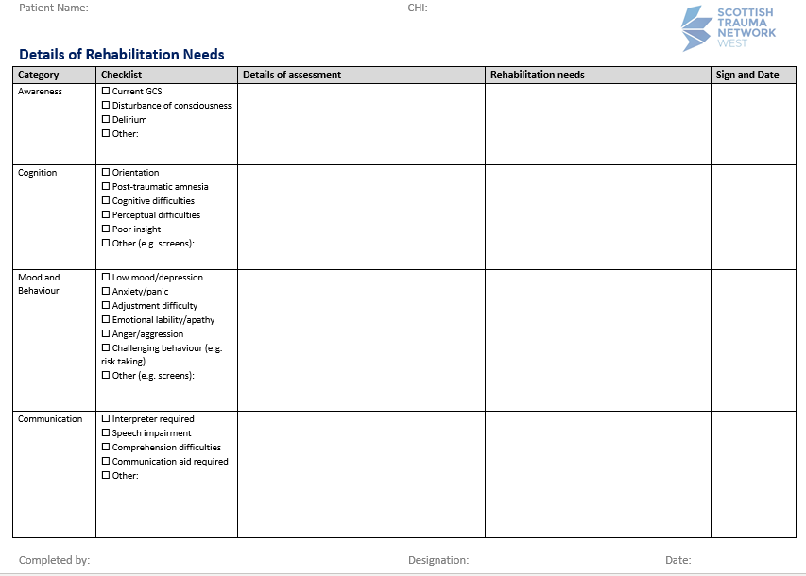
Awareness: GCS, following instructions, DOC - WHIM, Delirium – 4AT
Cognition: orientation, PTA, cognitive assessments
Mood and Behaviour: engagement and screening tools
Communication: language, comprehension aids, impairments
Notes:
For Awareness consider arousal including current GCS and whether patient is awake and alert. Comment on whether the patient is talking or following instructions. Detail any disorder of consciousness, if evidence of this then consider completing a WHIM score. Detail any evidence of delirium and consider completing a 4AT score.
For cognition, consider whether the patient is orientated and the need for Post Traumatic Amnesia (PTA) score. Comment on safety awareness, insight, perception and processing. Detail the outcome of any other formal cognitive assessments.
For mood and behaviour, describe any presence of altered mood or challenging behaviour and document how this is affecting engagement in rehab. Document any screening tools used e.g. HADS and any specific management required such as RMN supervision/1:1 supervision etc.
For communication, document the patient’s first language. Comment on comprehension, verbal output, reading, writing, voice and non-verbal language. Describe patient difficulties and any communication aids currently in use e.g. Picture board/paper and pen/lite-writer/simple one word commands with gesture. Document any visual or hearing impairments

Slide 15
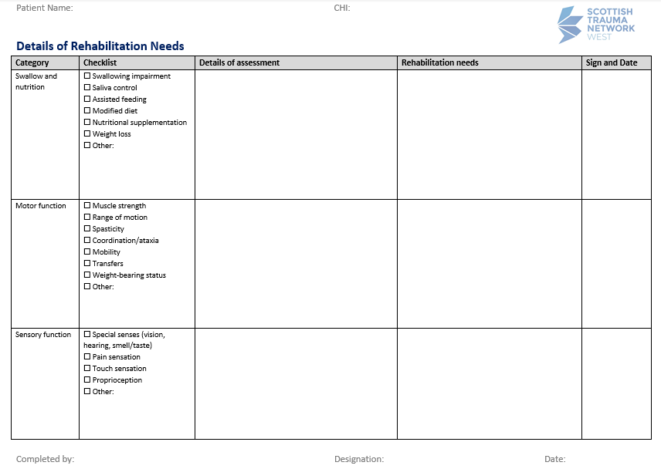
Swallow and Nutrition: impairments and support/recommendations
Motor function: strength and ROM, transfers/mobility
Sensory function: 5 senses, altered pain sensations
Notes:
For swallow and nutrition: Document any impairments and nutritional support required, and current SLT swallowing recommendations, such as positioning, level of assistance required, IDDSI diet and fluid levels. Record any significant weight changes.
For motor function: Record current physical assessment of strength and range of motion. Comment on presence of spasticity or issues with coordination. Detail how the patient is currently transferring and mobilising and how this should be progressed.
For sensory function: document any pre-existing issues with vision/hearing and any new problems. Record findings of assessment of altered pain sensation and proprioception. Comment on issues such as sensitisation, sympathetic changes or phantom sensations

Slide 16
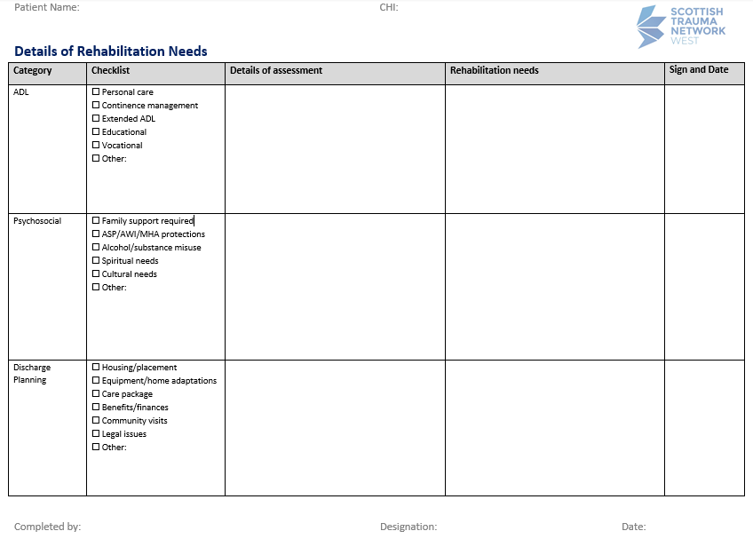
ADL: ability with personal care and instrumental tasks, vocational/educational
Psychosocial: capacity, safeguarding, spiritual/cultural, risky behaviours
Notes:
For Activities of daily living: Document current functional ability with regards to personal care, continence management and instrumental ADLs. Consider assistance for feeding and any aids required for any specific ADL tasks. Comment on educational or vocational needs.
For psychosocial: include details around capacity/AWI decisions, safeguarding concerns, spiritual or cultural considerations. Record details around support available and risky behaviours such as alcohol or substance misuse
For discharge planning: Include whether patient will be able to go home or will require re-housing, adaptations or a placement. Consider formal or informal social support required for d/c such as a package of care or supported discharge. Include details of welfare support and any other legal issues. In ‘other’ add details around what onward referrals are required

Slide 17
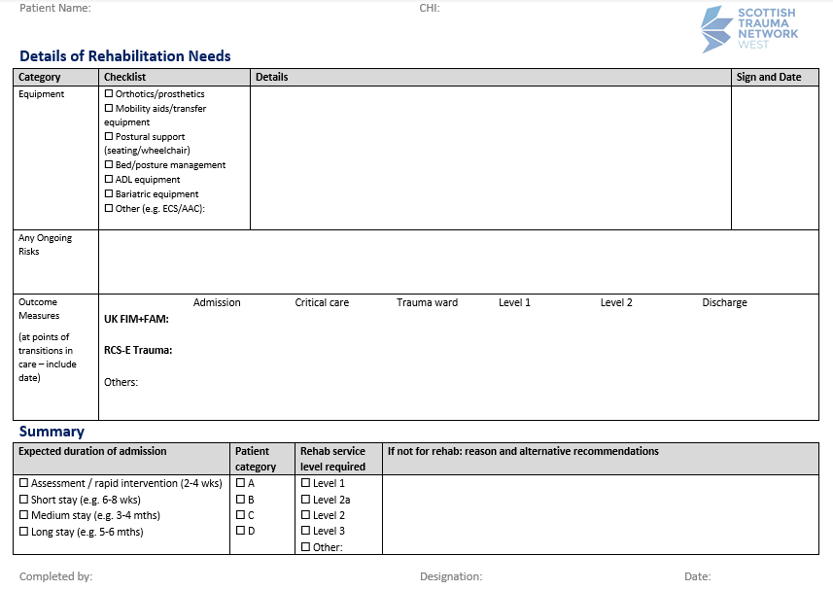
Equipment: Specialist equipment required
Ongoing risks: to interpersonal relationships
Outcome measures: document for all transitions of care
Summary: duration of admission, patient category, level of rehab, alternative recommendations
Notes:
For equipment: provide a summary of equipment that is required and in place for discharge. Include timeframes and whether essential for discharge or can be arranged thereafter. This may include things like: orthotic devices, wheel chairs, walking or transfer aids, ADL equipment or specialist communication aids.
For ongoing risks: document any risks for patient interpersonal relationships including aggressive behaviour, social and environmental risks (dogs/substance misuse/family members with history of violence).
For outcome measures: Document scores for any outcome measures used at all points of transition in care. The RCS and FIM/FAM and headings in the table are suggested but you may want to agree a toolkit for use locally, or use different measures depending on the patient.
The summary box: should detail the expected duration of admission based on clinical judgement, as well as details on the patient category of needs and the level of rehab required. If a patient is not for rehab, document here the reason for the decision and the alternative recommendations in place.

Slide 18
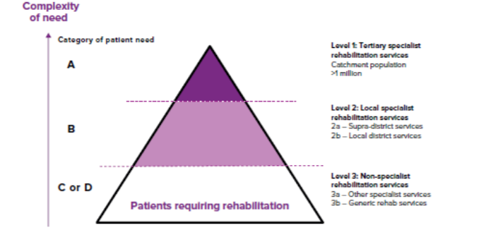
Patient Categorisation
PCAT Tool Template BSRM Levels of Rehab
Notes:
The BSRM recognises three levels of service ranging from level 1 (highly specialist) to level 3 (generic) and four levels of patients need ranging from Category A (high complexity) to D (low complexity).
Category A patients have very complex rehabilitation needs and need specialist inpatient rehabilitation delivered by a multi-professional team led by a Consultant in Rehabilitation Medicine. Patients may be medically unstable and may still require direct input from their acute major trauma teams. They may require involvement of 5 or more therapy disciplines. Category A patients include those with tracheostomies who are being actively weaned, those who require ventilation, and those with Prolonged Disorder of Consciousness. It also includes patients with brain injury who have severe cognitive deficits and highly challenging behaviours requiring rehabilitation.
Category B Patients also have complex rehabilitation needs and require specialist inpatient MDT rehab led by a Consultant in Rehabilitation Medicine. Patients are usually medically stable. The involvement of multiple therapy disciplines is required. Patients with stable tracheostomy who are not being weaned and those with brain injury and cognitive deficits who can be managed in a structured environment have Category B needs.
Category C and D Patients do not require specialist rehabilitation, but have needs which can be met by a non-specialist team in either a hospital or intermediate care facility. Fewer therapy disciplines may need to be involved. Most patients with musculoskeletal injuries who need inpatient rehabilitation and the frail elderly who have complex medical needs are also likely to have Category C rehabilitation needs.
The patient categorisation tool (PCAT) has been developed to assist clinicians in identifying the patient category of needs and this can be accessed via the link on the left of screen. If you want to read more about the BSRM levels of rehab then follow the link on the right of the screen

Slide 19
Notes:
The majority of major trauma patients will have category C or D rehab needs that will be appropriately met by local level 3 non specialist services, whether that is via generic inpatient rehabilitation in an intermediate care facility, or delivered at home via supported discharge services, community or outpatients therapy services.
Patients with more complex category A or B rehab needs, will have those needs met by regional (level 1) or local (level 2) specialist inpatient rehab settings respectively.
Defining patient need and rehab levels in this way is well established down in England and form a useful framework for planning and delivery of specialist rehabilitation services. However, a lot of services in Scotland are not used to being defined in this way, and often services can provide more than one level of care in the same unit. Starting to indicate the category of need and level of rehab needed in the rehabilitation plan will help us to understand whether our patients needs are being met by the services we refer to.

Slide 20
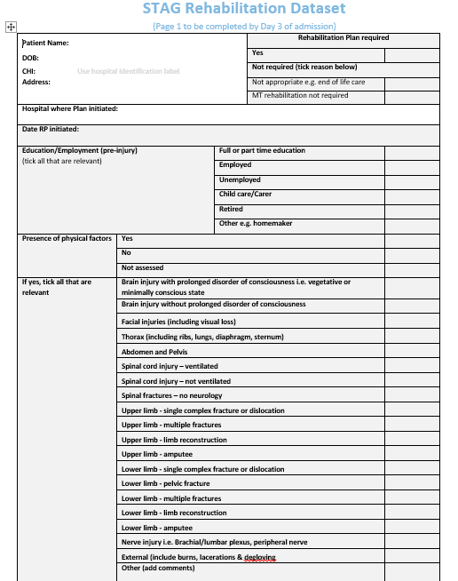

STAG Rehabilitation Minimum Dataset
Developed by STAG
Will be completed by MT co-ordinators or other designated person
Saved in patients notes for ease of access for LACs
Notes:
The final part to the rehabilitation plan process, is to document clearly in your clinical records that the written rehabilitation plan has been completed and when it was done. The rehabilitation minimum dataset has been developed by STAG to give the local audit coordinators easy access to the audit data they require in order to report on the KPIs. This dataset checklist needs to be completed by day 30 or by discharge and will often be completed by a Major Trauma Coordinator or other designated person. Discuss the local arrangements in your area.

Slide 21
Benefits
Promotes patient centred care
Encourages early use of goal setting
Patient led - engage and empower the patient in rehabilitation
Improves communication between the patient and clinicians
Ensures a clear plan is in place so streamlines patient journey
Improved patient outcomes
Notes:
Hopefully the benefits to completing the rehabilitation plan are now clear. The process promotes true patient centred care and encourages the early use of goal setting and can help manage expectations, preparing patients for the journey ahead. As this process is patient led, they should feel empowered to be involved in the planning and delivery of their rehabilitation. It will improve communication and information transfer between the patient, clinicians and care providers helping to stop things slipping through the net by ensuring clear plans are in place. This should help to streamline the patient journey and ultimately improve outcomes for our patients.

Slide 22
Thanks for listening!
Any questions/comments??
Contact:
South East: Sophie.peacock@nhslothian.scot.nhs.uk
West: Karen.Scott2@ggc.scot.nhs.uk
Notes:
Thankyou for taking the time to listen to this presentation. Hopefully you understand the rationale, purpose and benefits of the Rehabilitation Plan and that you now feel more confident to effectively complete them with patients who have suffered major trauma. If you have any questions or want to provide some feedback then please get in touch via the email addresses on the screen.

